Slide 1


Slide 2

This is a new project type supported by VB.NET, where programmers can easily create Console Applications
Console Applications are executed/run in the DOS environment which is called the DOS Box or command prompt
Such applications do not have any graphical-user interface(GUI)/visual interface
Console Applications allow
  Reading of characters from the console
  Writing characters to the console

Slide 3

Yes! This is because
  Console application can be build to test a specific feature of the language without having to build a user interface.

Slide 4

The Visual Basic Code is written in the body of the Main() subroutine i.e within Sub Main()…End Sub
Skeleton of the Module
Module Module1
Sub Main()
‘body of the subroutine
End Sub()
End Module
When we run the application, the execution will begin from the first line in Main() onwards and ends when End Sub() is encountered

Slide 5

Unlike windows application, which is a class, a Console application is a module.
Main() is the name of a subroutine that’s executed automatically when we run a Console application.
A Console application doesn’t react to events, because it has no visible interface.

Slide 6

To read characters from the console, we used the function Console.ReadLine()
Syntax
  <variable_name>=Console.ReadLine()
  Console.ReadLine()
This function will return the value inputted by the user i.e. after the user presses the enter key
  If required, the value returned may be assigned to a variable provided, as shown in 1
  If value not required, like a key press event for viewing the output of the application, we can call the function as shown in 2

Slide 7

To write characters to the console we can make use of the Console.Write() Functions & Console.WriteLine() Functions
Syntax
  Console.Write(arguments)
  This will write whatever is provided as arguments to the console, such as text, numeric values, etc.
  Console.WriteLine(arguments)
  This performs the same task as above statement but also inserts a line break after writing the arguments to the console

Slide 8

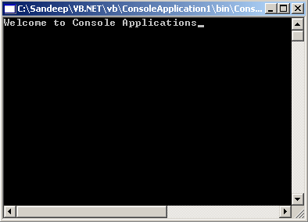
Module Module1
Sub Main()
Console.Write(“Welcome To Console Applications”)
End Sub
End Module

Slide 9

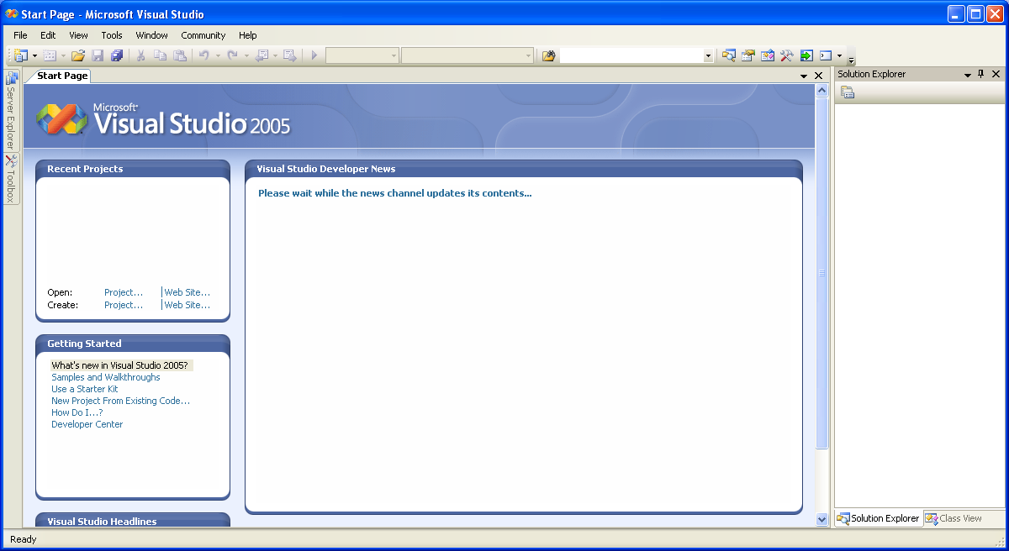
1. We need to open Visual Studio

Slide 10

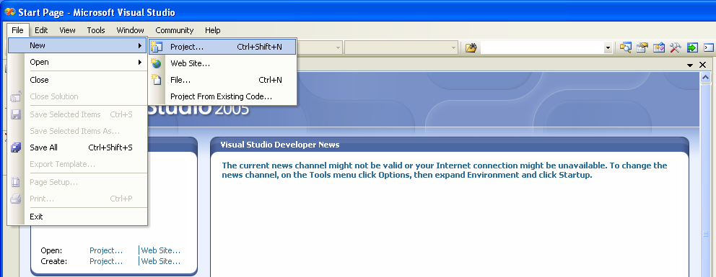

Slide 11

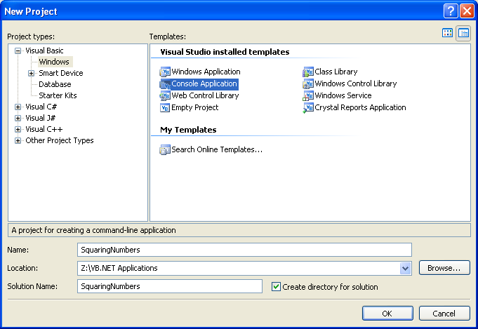
1. Choose Type of Project
2. Give Proper Name to the application
3. Choose Location
4. Click OK

Slide 12

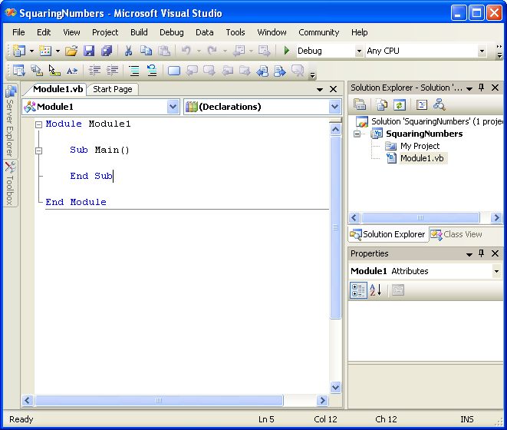
Project Loaded/Open

Slide 13

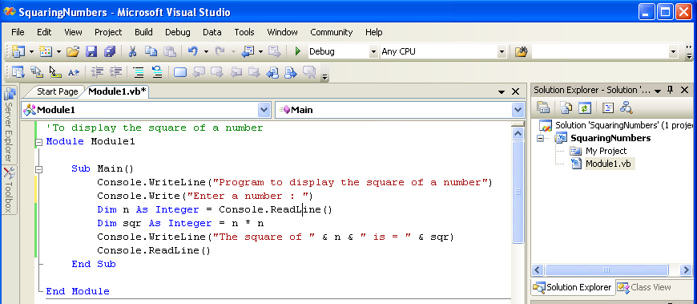
Declaration should be usually after Sub Main
Such declarations is discouraged

Slide 14

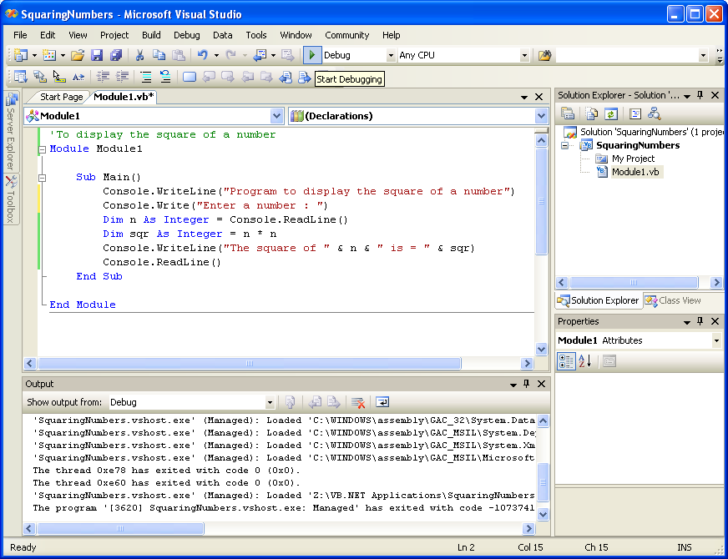
Click Here
Press F5 or….

Slide 15

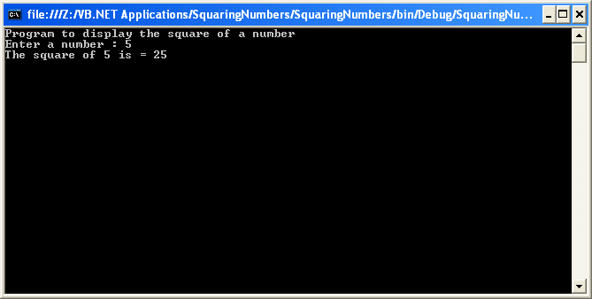

Slide 16

Write a VB.NET program which includes a main subroutine for calculating the sum(+), difference(-), product(*) and division(/) of two numbers.

Slide 17

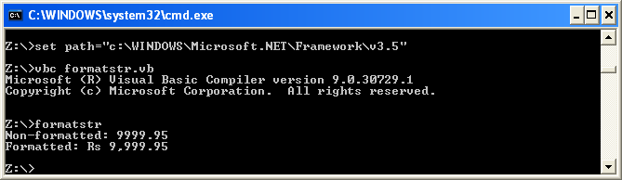
Write the VB Application in a text editor like Notepad etc.
Save the file with the extension .vb in a particular location
To compile & run the VB application/programme

Slide 18


